Slide 1

ECE 802, Electric Motor Control
Permanent-Magnet Ac Motor Drives

Slide 2
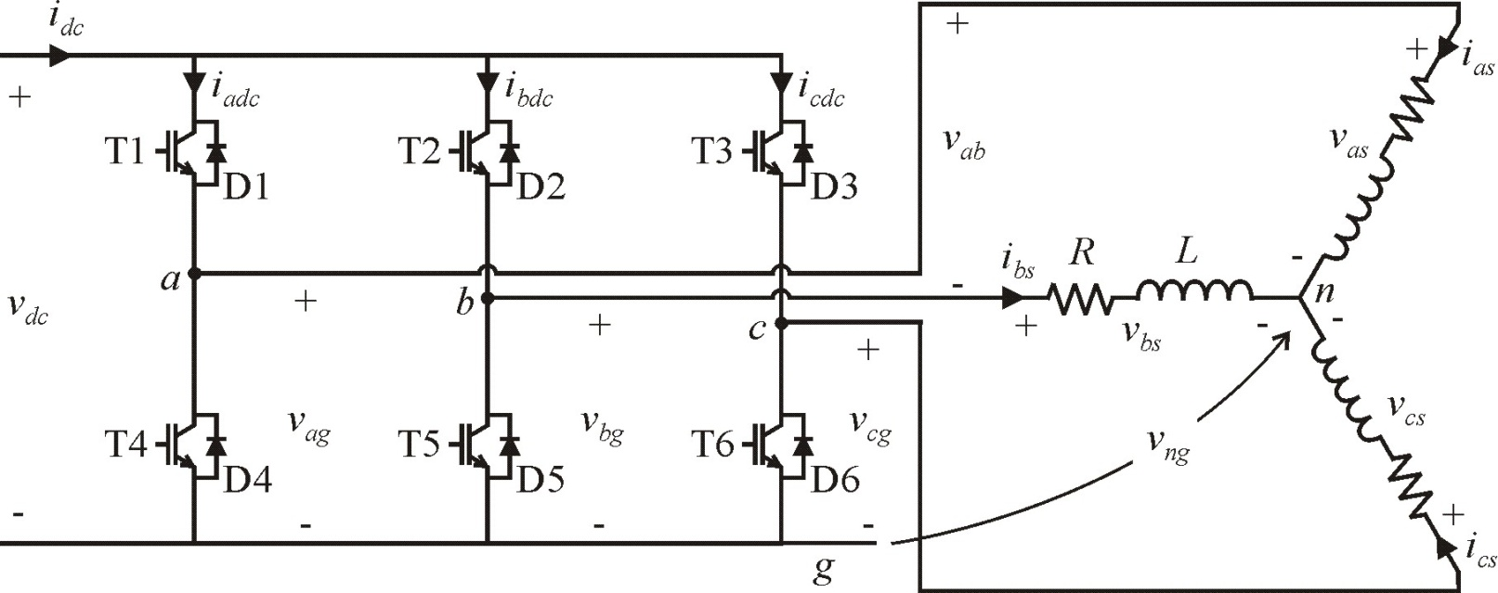
Inverters (Chapter 12)

Slide 3
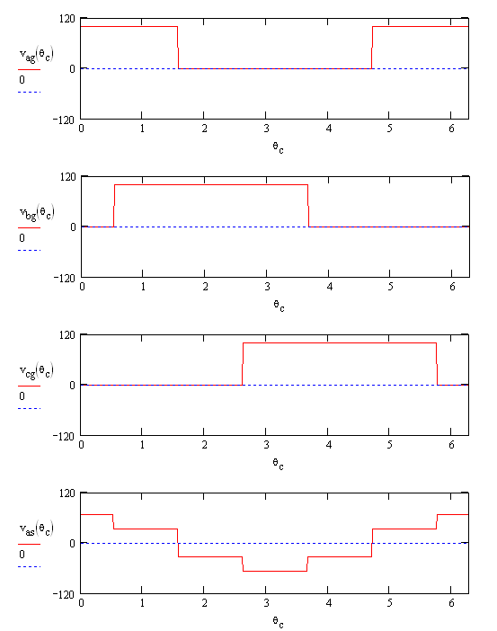
180º Voltage Source Inverter (VSI) Control
1 1 0 0 0 1 1
θ_{c} = 2πft
R = 2 Ω
L = 1 mH
f = 100 Hz
v_{dc} = 100 V
v_{as1} = 63.7 V
0 1 1 1 0 0 0
0 0 0 1 1 1 0

Slide 4
Sine-Triangle Modulation
duty cycles
modulation index
electrical angle

Slide 5
Sine-Triangle Modulation
Compare d_{a}, d_{b}, and d_{c} to a high-frequency triangle wave (period T_{sw} = 1/f_{sw})
switching rules
Typically 2kHz ≤ f_{sw} ≤ 20kHz for industrial drives

Slide 6
Sine-Triangle Modulation Waveforms
In this example:
f = 60 Hz
f_{sw} = 6 kHz

Slide 7
Sine-Triangle Example Calculations

Slide 8
Sine-Triangle Simulink Example
Inverter_Bridge.mdl

Slide 9
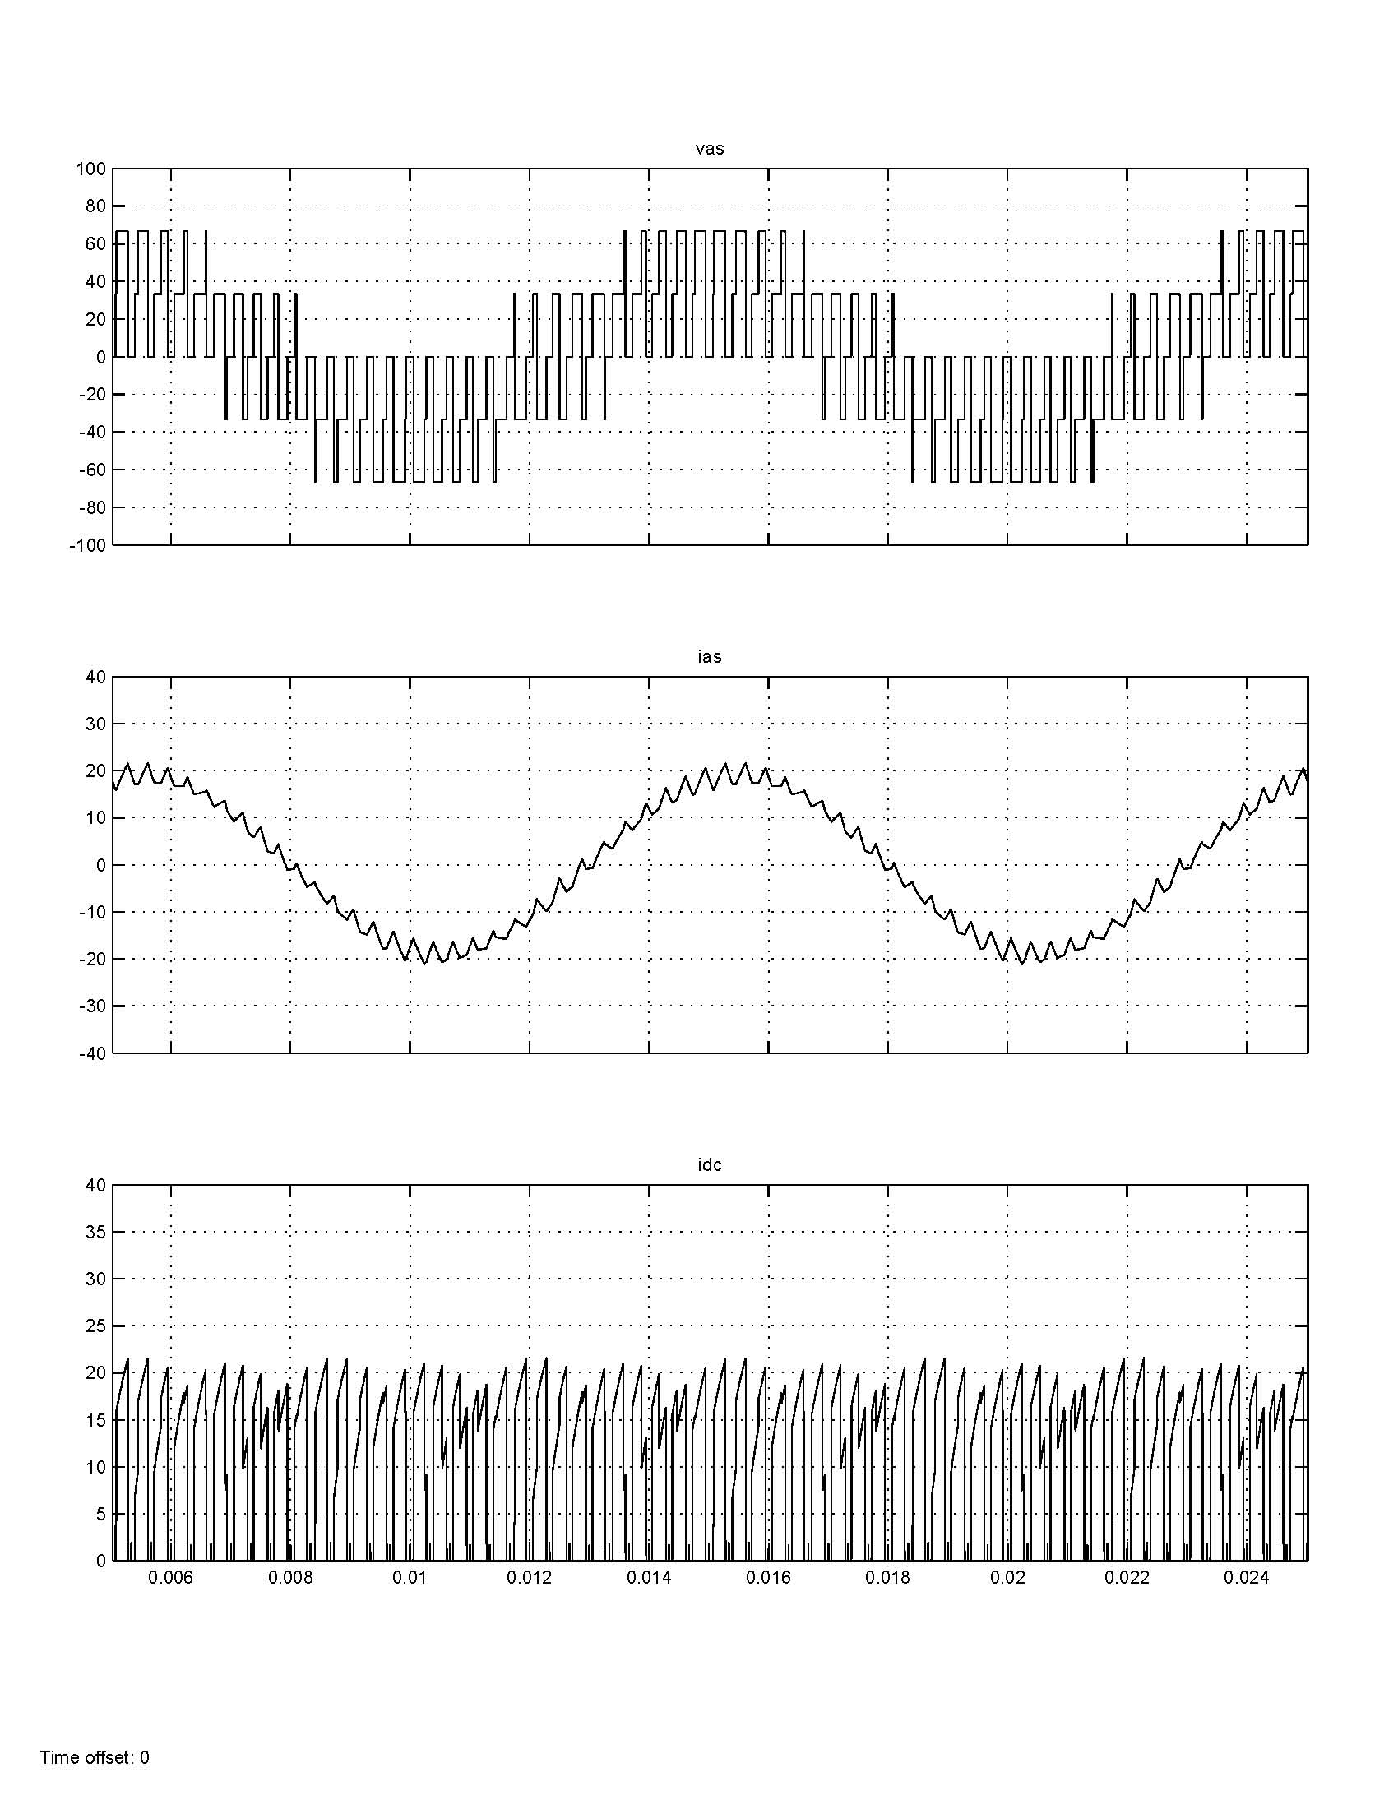
Sine-Triangle Simulink Plots

Slide 10
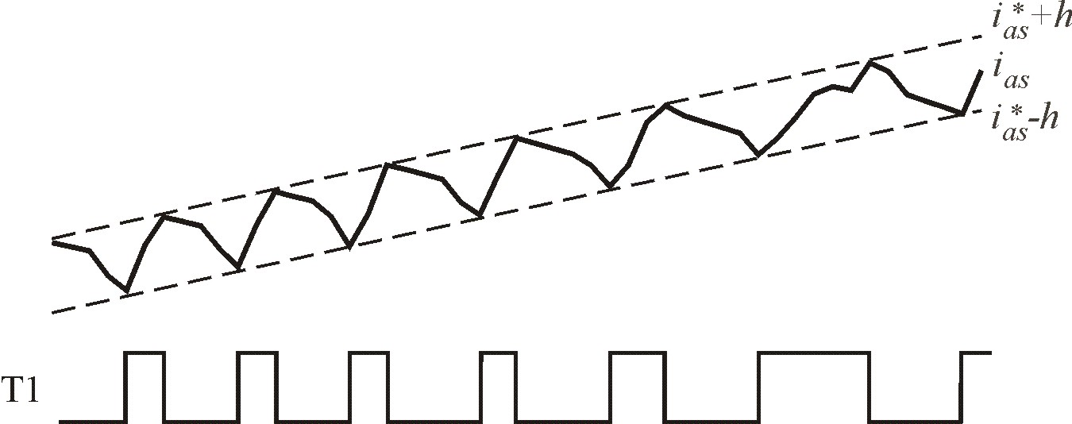
Hysterisis Control
switch transistors on a per-phase basis based on current
h = hysteresis level (A)
note the effect on load voltage

Slide 11
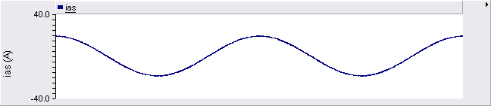
Hysterisis Control Performance
make h small, then current is nearly ideal
Advantages: Direct control of currents
Disadvantages: Irregular switching frequencies
Typically analog implementation

Slide 12
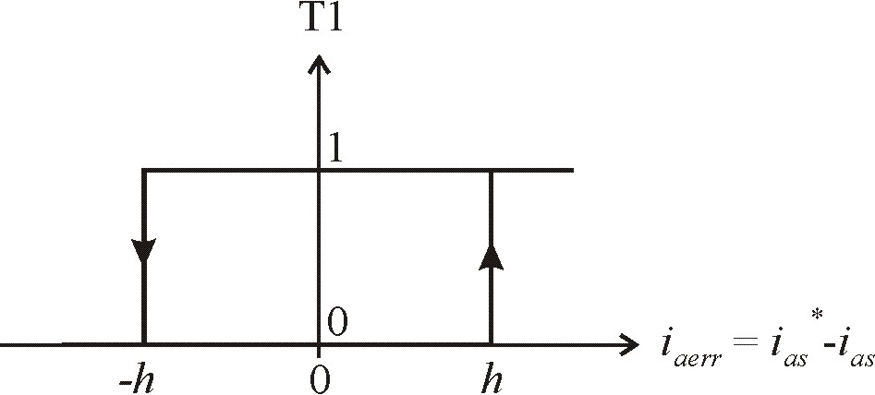
Hysteresis Plot
plot switching state versus current error

Slide 13
Hysteresis Control Calculations

Slide 14
Hysteresis Control Simulation in Simulink
Inverter_Hysteresis.mdl

Slide 15
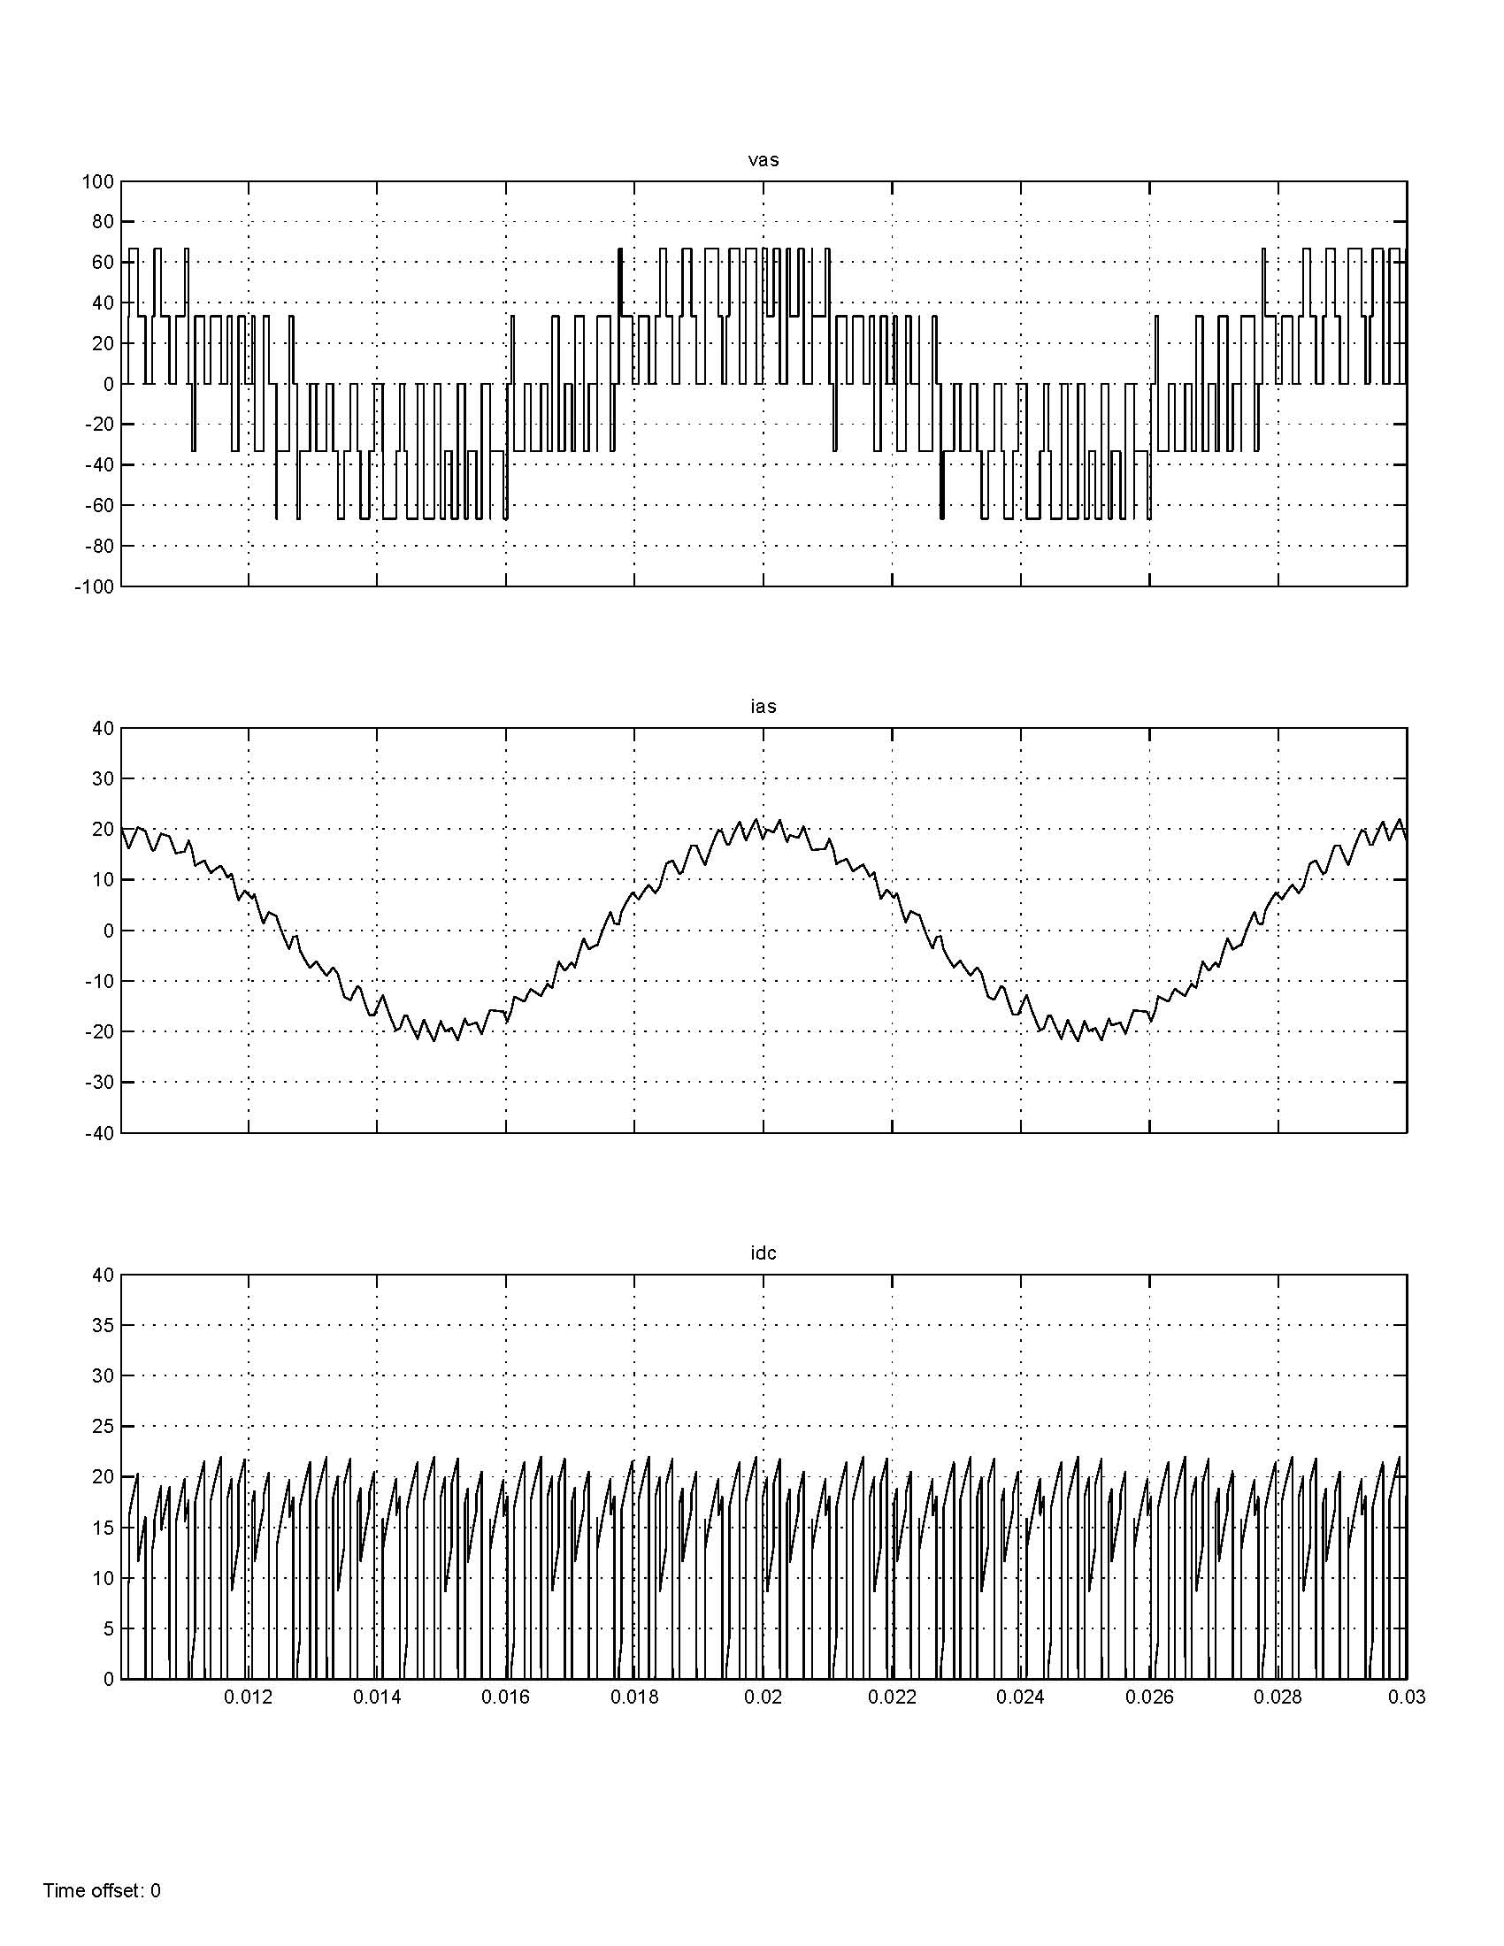
Hysteresis Control Simulink Waveforms

Slide 16
Inverters and Control
Voltage-source control
180 degree VSI
simple, low-performance control
ac voltage dependant on dc voltage
Sine-triangle modulation
good harmonic performance
control of voltage magnitude through modulation index
Current-regulated control
Hysteresis control
direct control of the inverter currents (with limitation)
irregular switching

Slide 17
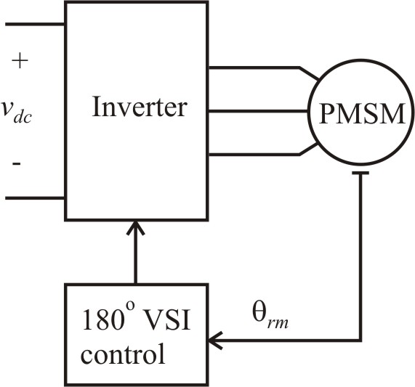
Six-Step Drive Example (Chapter 14)
For desired V_{s}
study 1: V_{s} = 90V so V_{dc} = 200V
study 2: V_{s} = 79.4V so V_{dc} = 176V

Slide 18
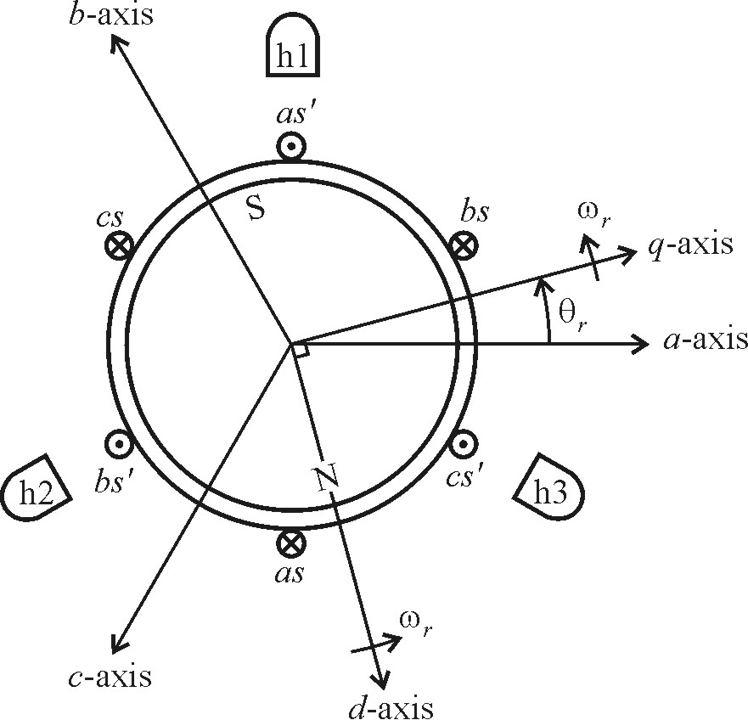
Hall Effect Sensors

Slide 19
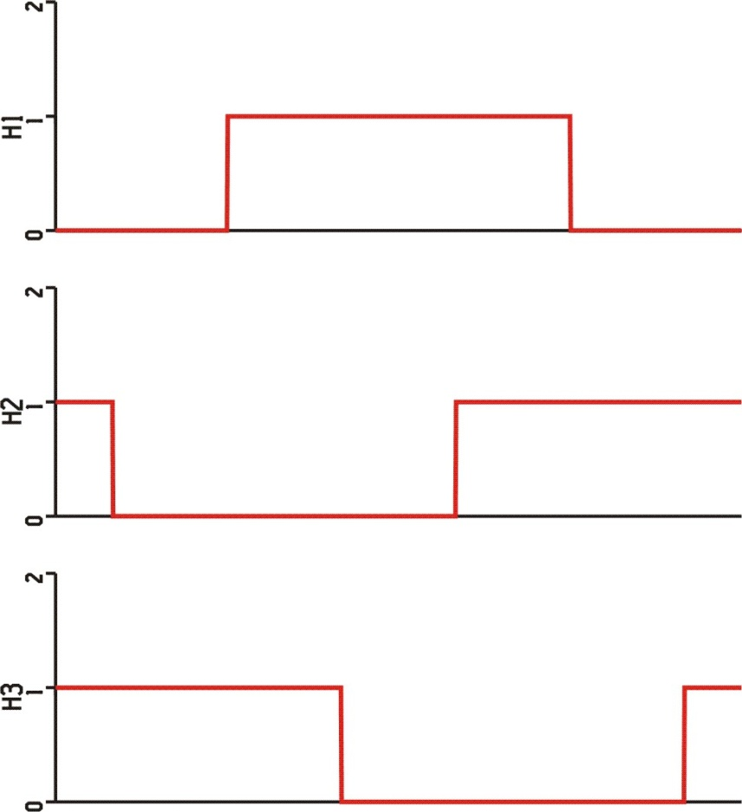
Hall Effect Sensor Signals
For six-step 180º VSI control, set

Slide 20
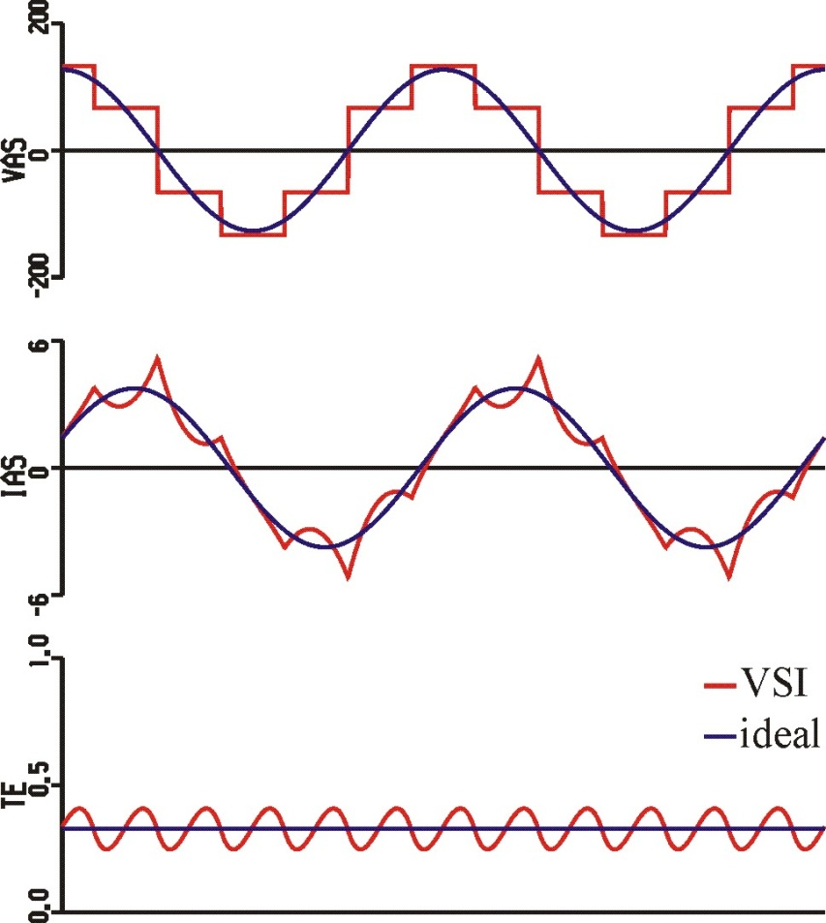
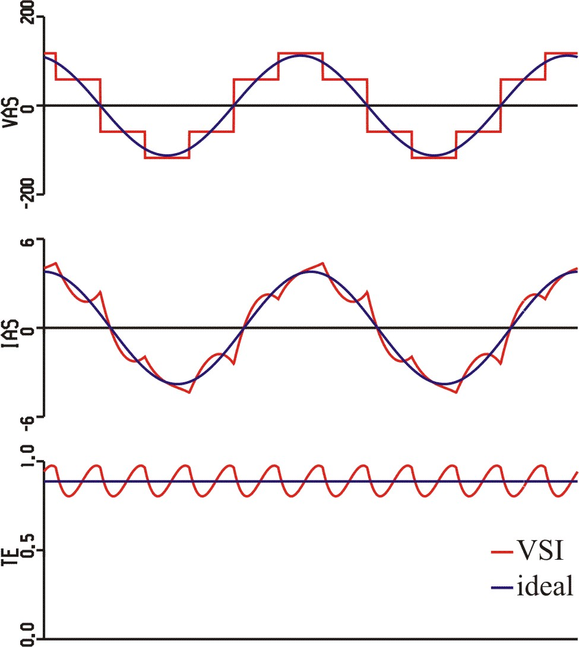
Six-Step Drive Waveforms
φ_{v} = 0
φ_{v} = 14º

Slide 21
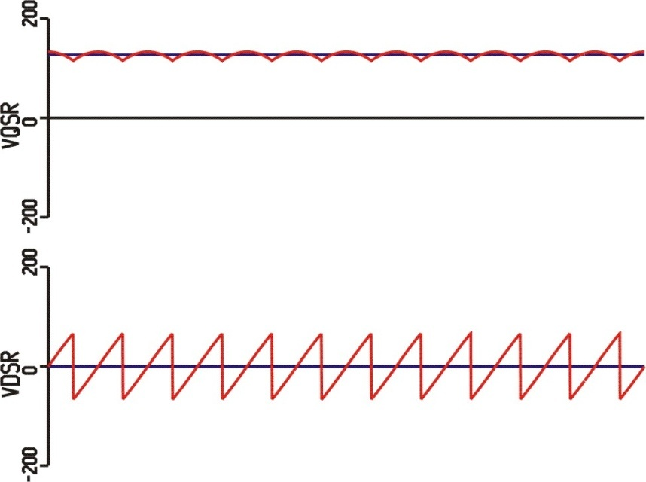
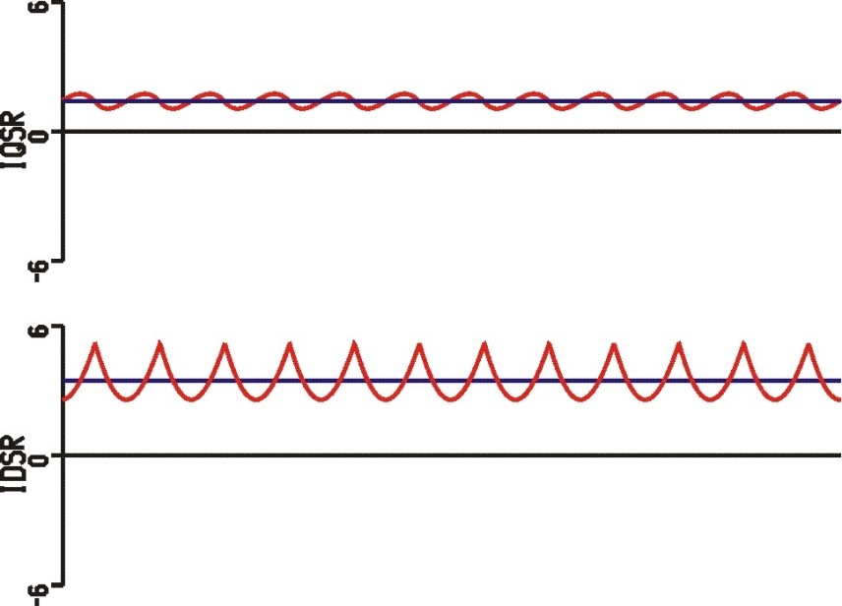
Six-Step Drive Waveforms φ_{v} = 0
voltages in q-d
currents in q-d

Slide 22
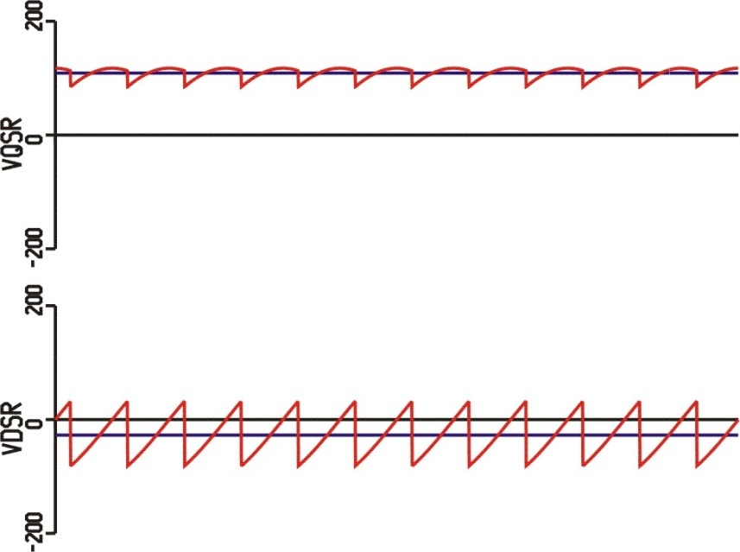
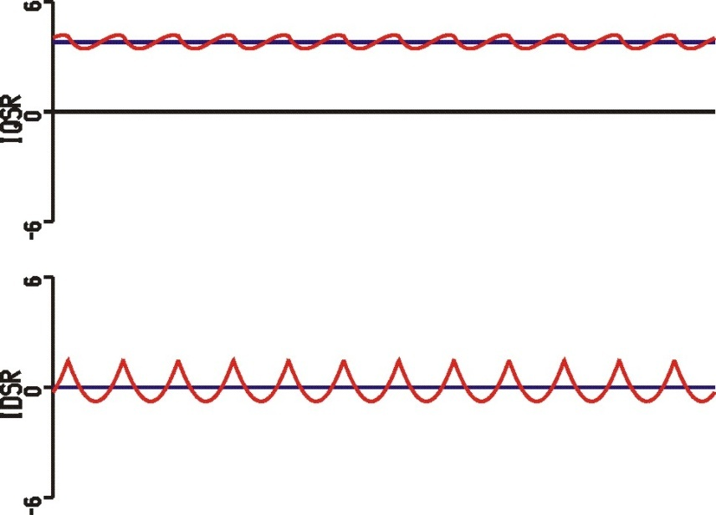
Six-Step Drive Waveforms φ_{v} = 14º
voltages in q-d
currents in q-d

Slide 23
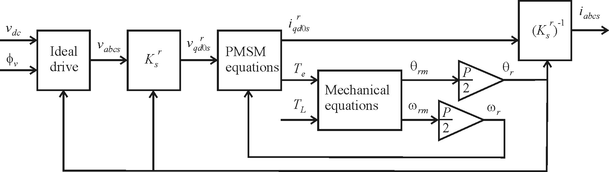
Dynamic Studies
V_{s} = 90V, φ_{v} = 0
motor parameters from previous example
mechanical equations
J = 0.01 kg∙m²
B = 0 kg∙m²/sec
T_{L} = 0.33 N∙m

Slide 24
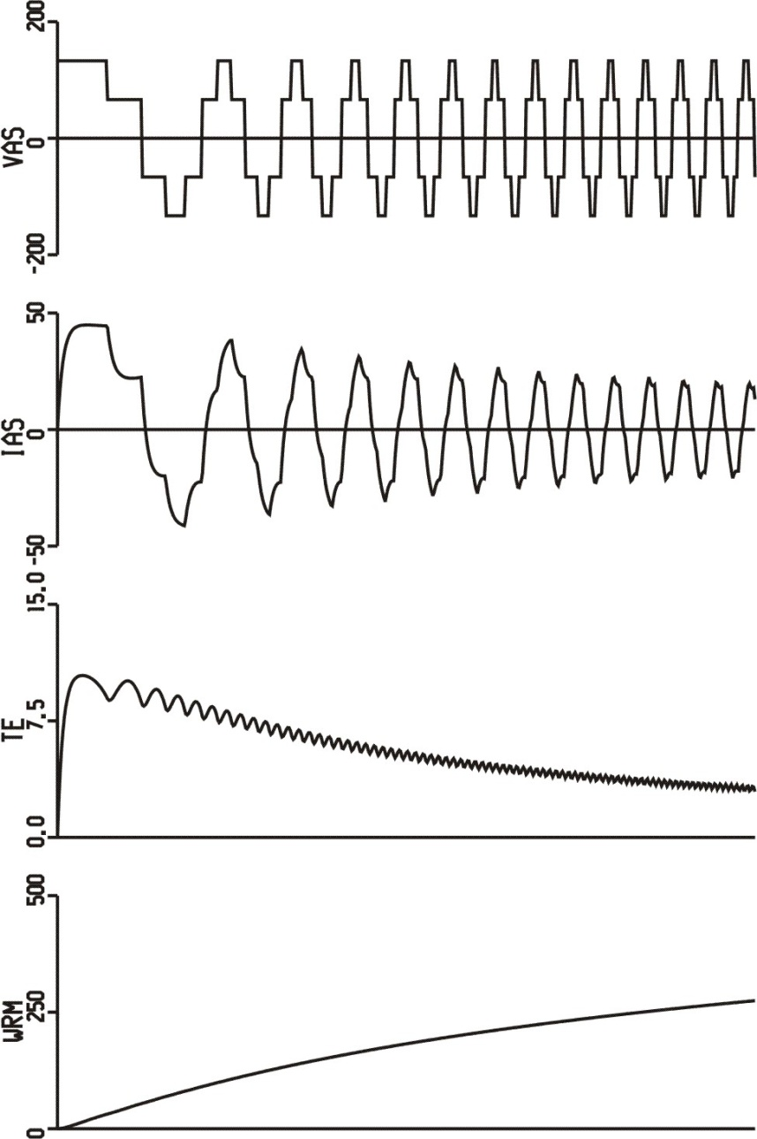
Start-up Study with 180º VSI Drive

Slide 25

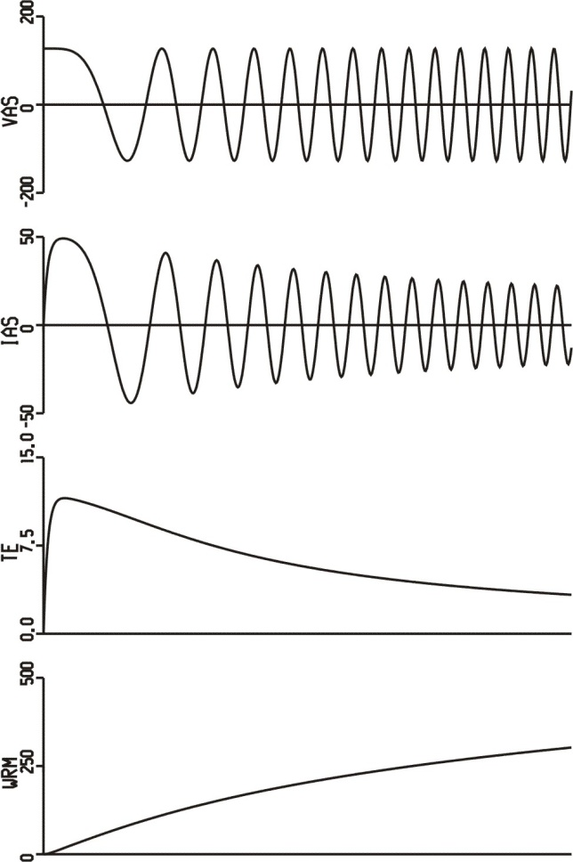
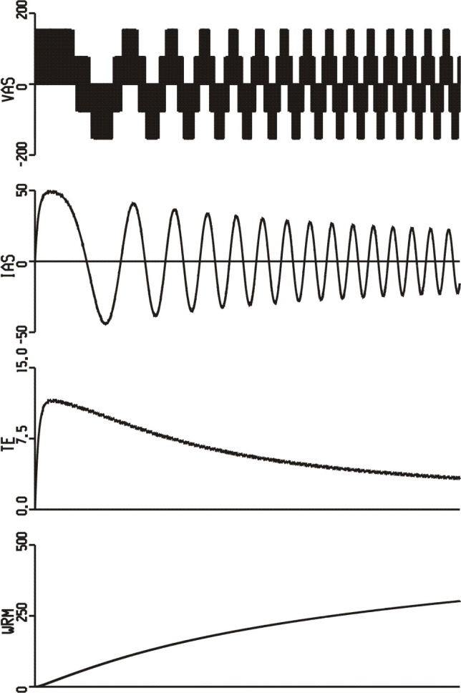
Dynamic Study
180º VSI
ideal drive
sine-triangle

Slide 26
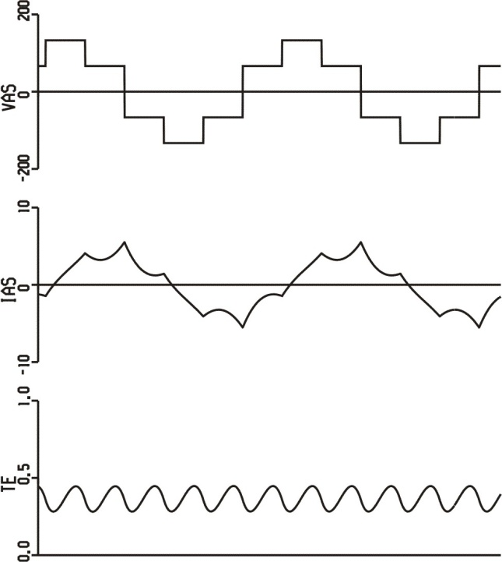
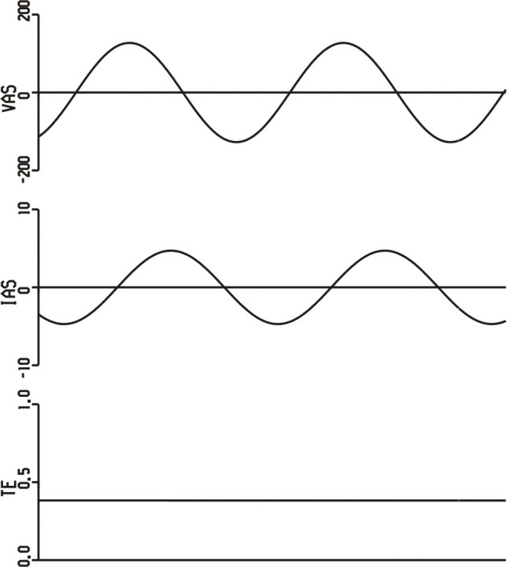
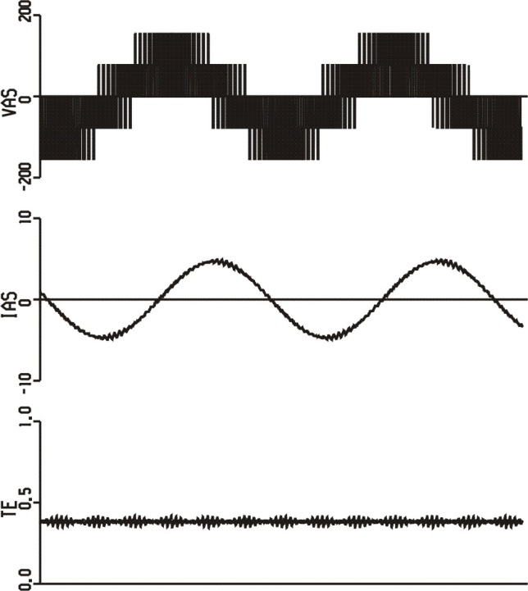
Steady-State Waveforms
180º VSI
ideal drive
sine-triangle

Slide 27
Ideal BDC Drive in PSCAD
BDC_Ideal.psc

Slide 28
PMSM Mechanical Model
BDC_Ideal.psc

Slide 29
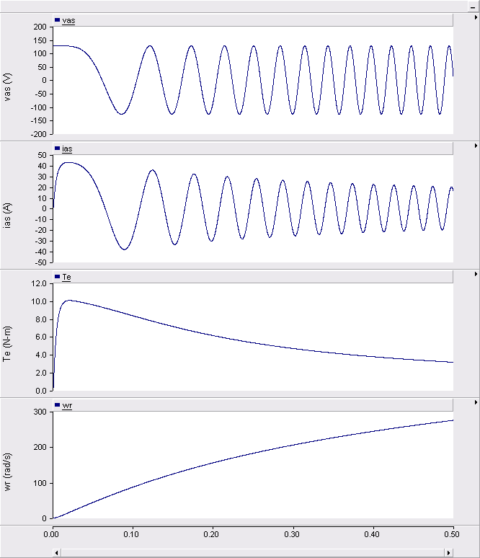
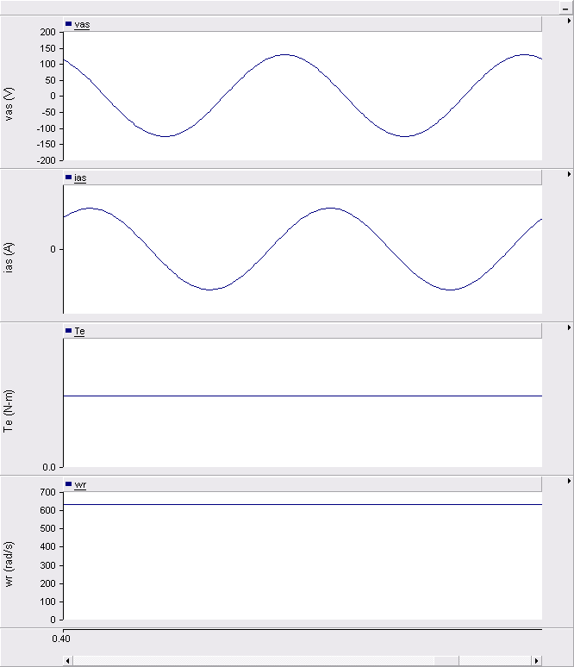
Ideal BDC Drive waveforms
start-up
steady-state

Slide 30
180º VSI BDC Drive in PSCAD
BDC_180_VSI.psc

Slide 31
180º VSI Transistor Switching
BDC_180_VSI.psc

Slide 32
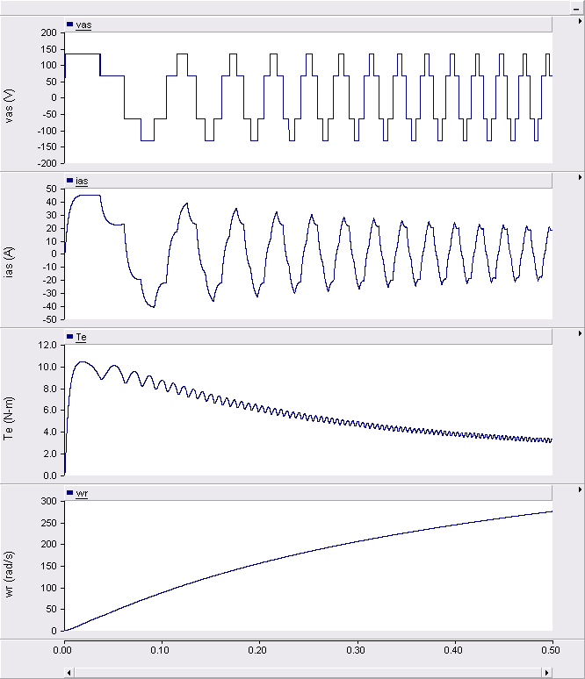
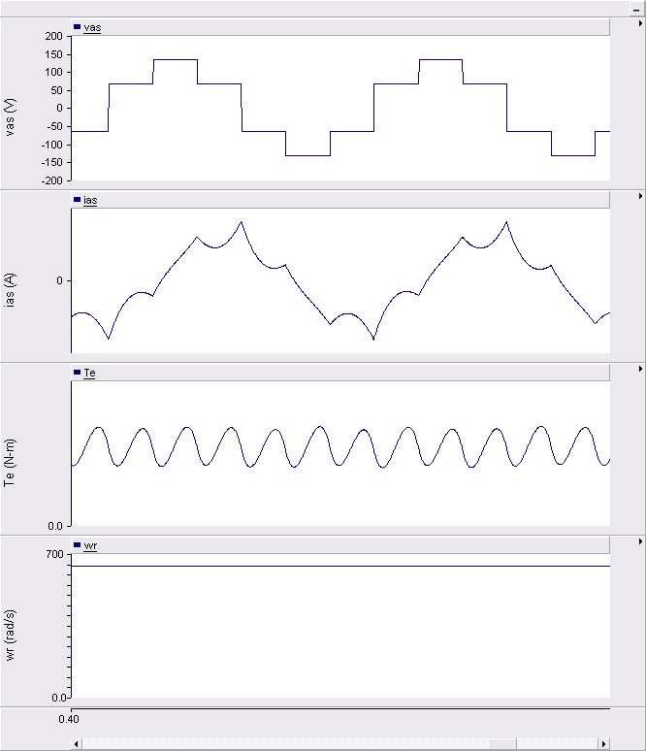
180º VSI BDC Drive waveforms
start-up
steady-state

Slide 33
Sine-Triangle BDC Drive in PSCAD
BDC_sine_triangle.psc

Slide 34
Sine-Triangle Transistor Switching
BDC_sine_triangle.psc

Slide 35
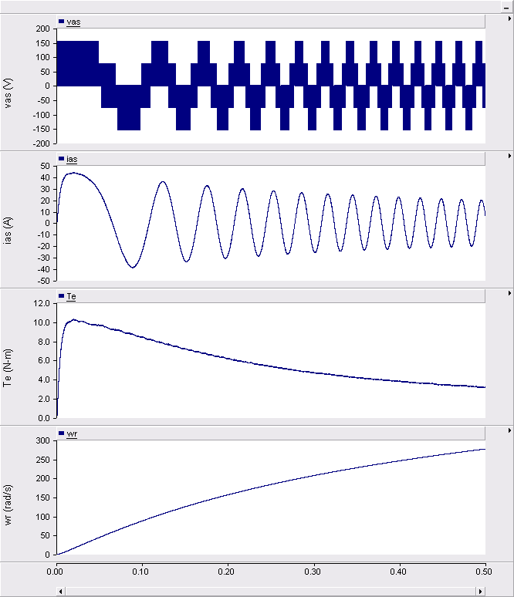
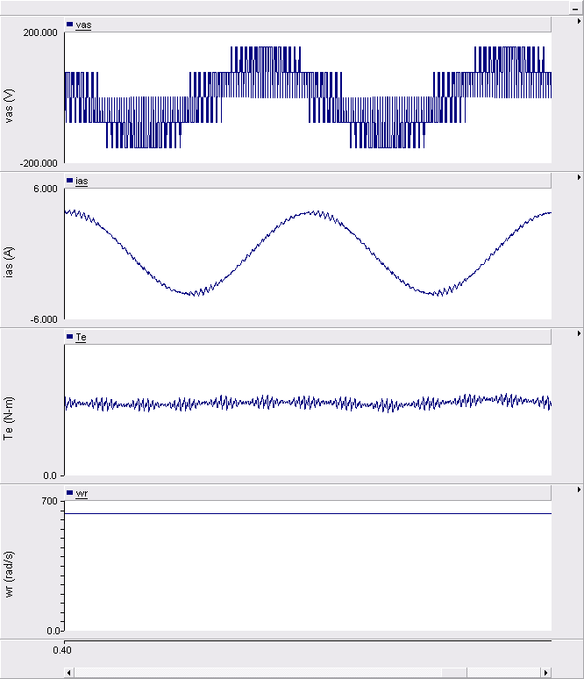
Sine-Triangle BDC Drive waveforms
start-up
steady-state

Slide 36
BDC Steady-State and Dynamic Performance
Steady-state calculations are carried out by treating the q-d model as a dc circuit.
For low-end brushless dc machines, the transistor signals can be directly determined from low-cost Hall-effect sensors.
Any state variable in a simulation, including rotor speed, can be replaced by a constant value or set to an initial condition to validate the steady-state calculations.

Slide 37
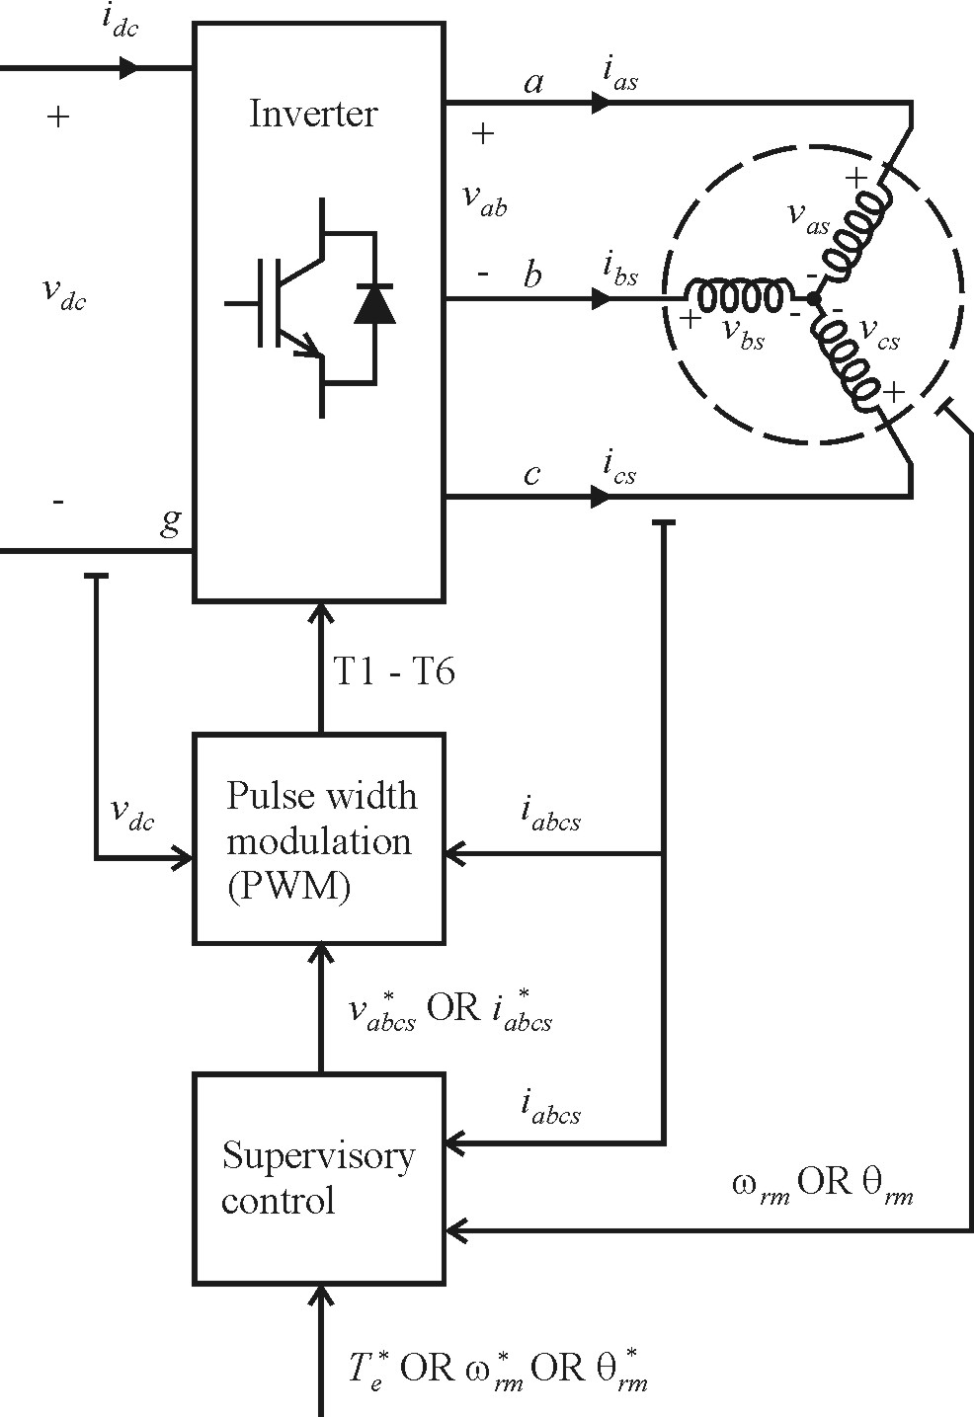
General Ac Drive System Structure
PWM control
switch level control
nanosecond / microsecond time scale
"hardware manager"
usually implemented in PLD
Supervisory control
overall drive system control
microsecond time scale
"application manager"
usually implemented in DSP

Slide 38
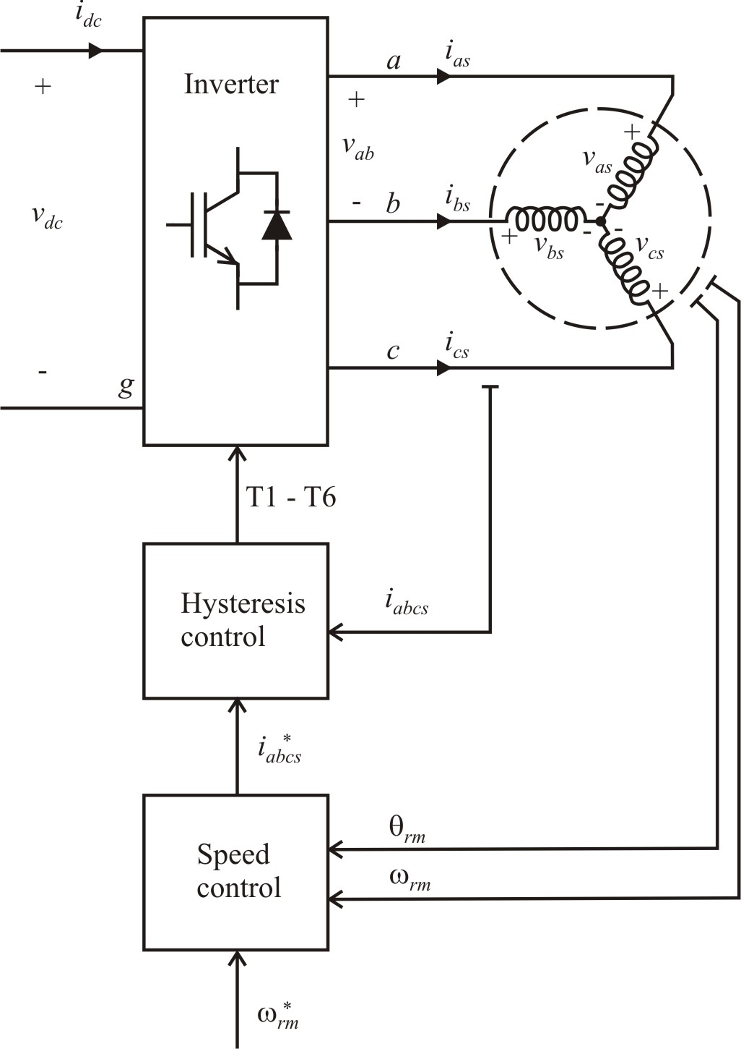
Brushless Dc Drive with Current Regulation
PMSM motor
hysteresis modulation
current regulation with φ_{i} = 0
speed control: PI
vehicle system
see book Figure 14.12-1

Slide 39
Vehicle Calculations

Slide 40
Steady-State Vehicle Calculations

Slide 41
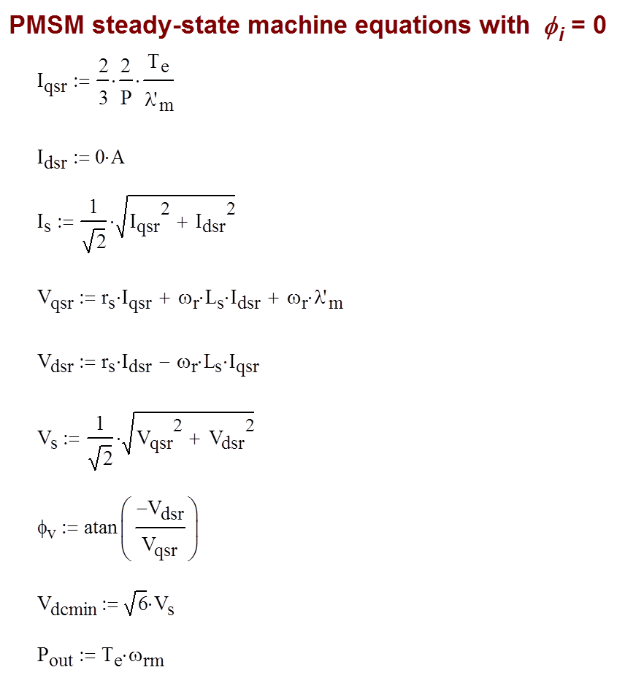
Permanent-Magnet Ac Machine Calculations

Slide 42
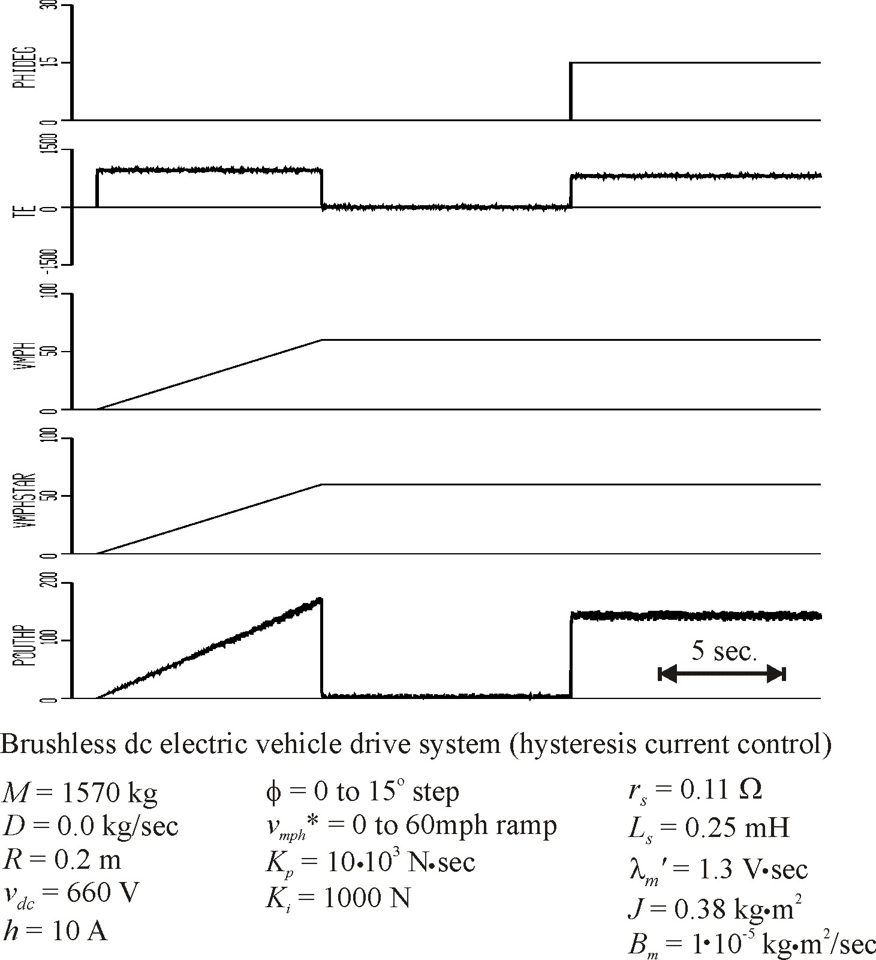

Slide 43
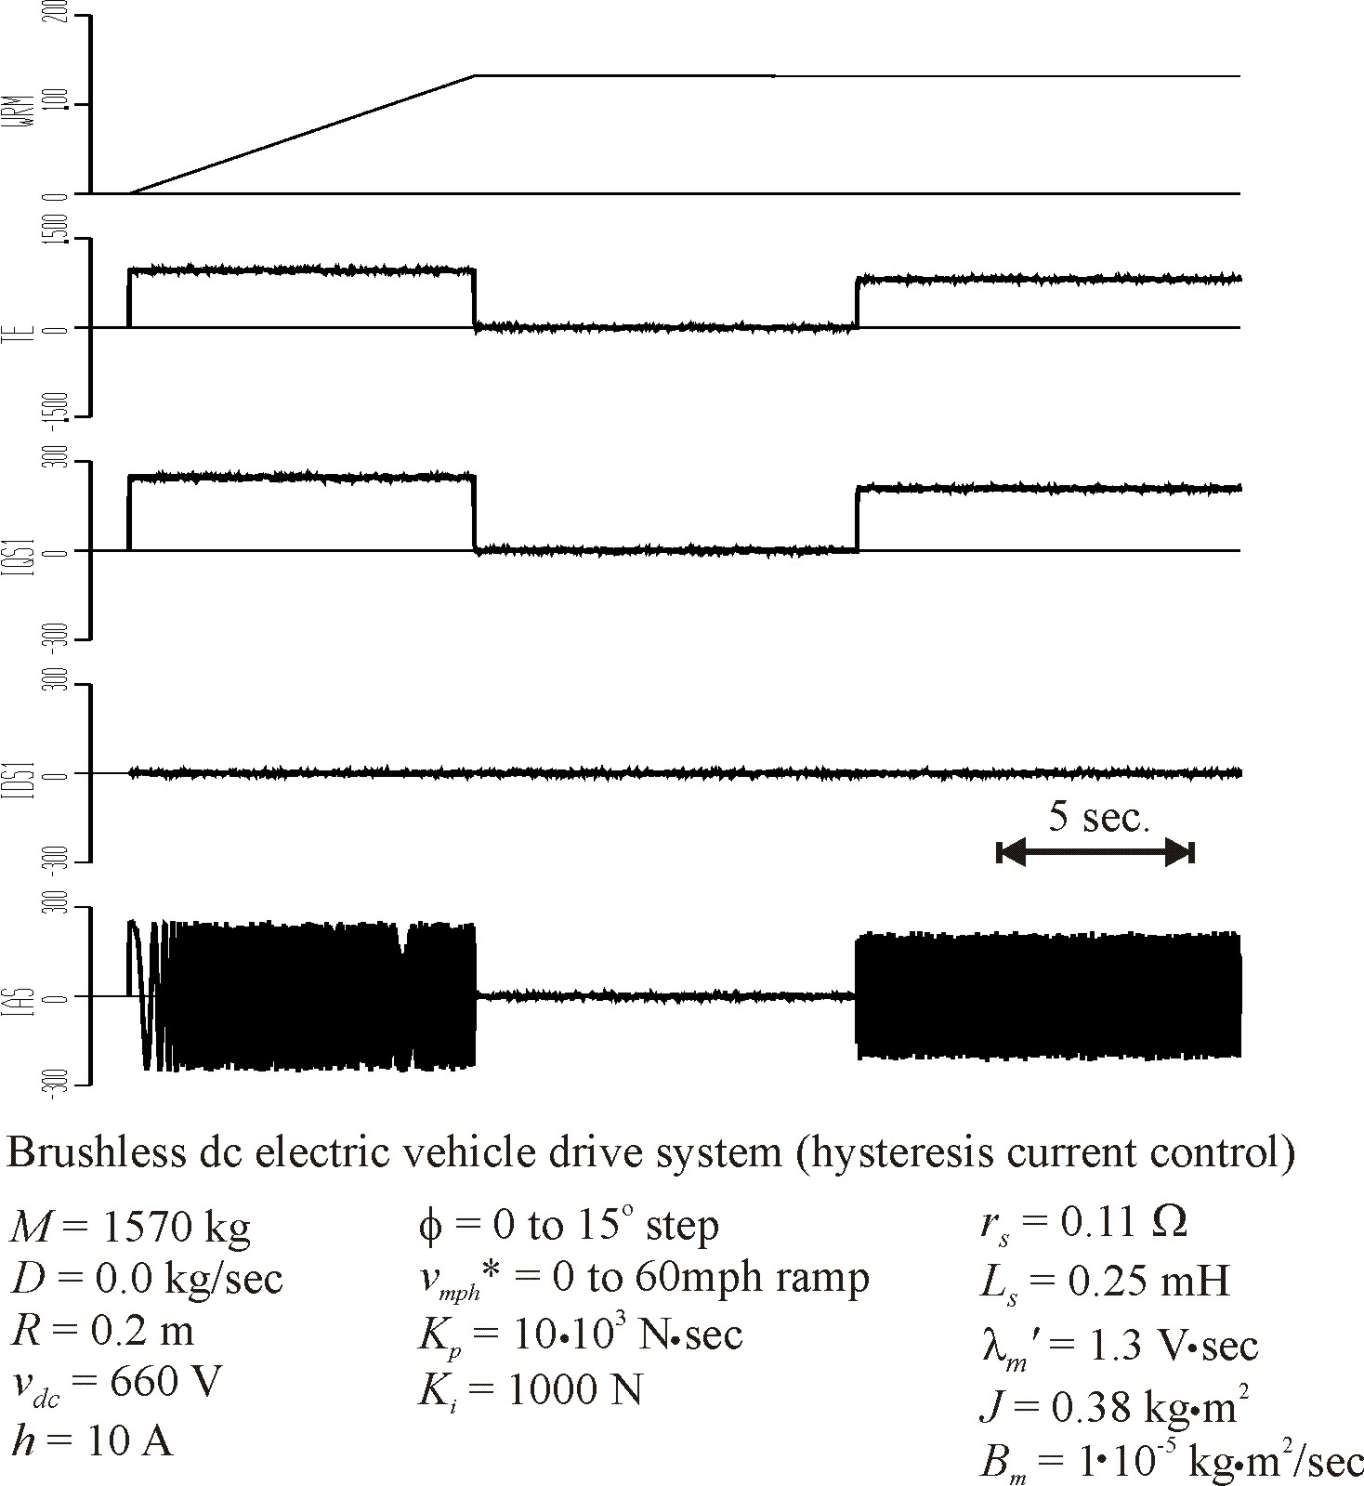

Slide 44
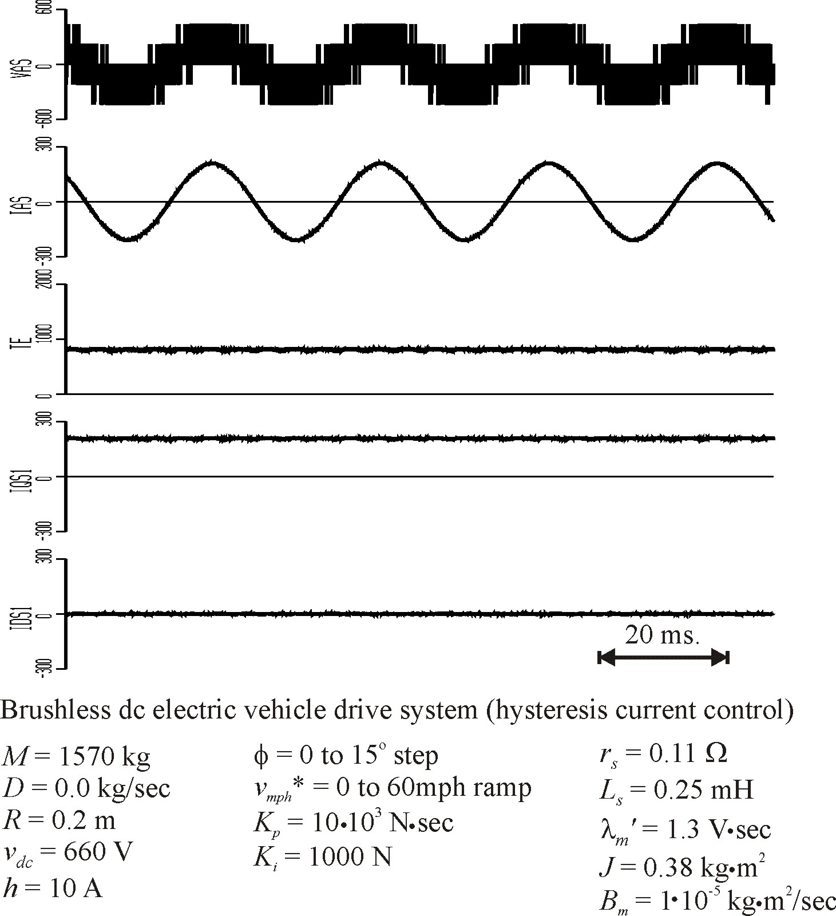

Slide 45
Current-Regulated Drive with Speed Control
An effective brushless dc drive was created by using hysteresis current-regulated PWM.
Steady-state and dynamic simulation show the effectiveness of the control.

Slide 46
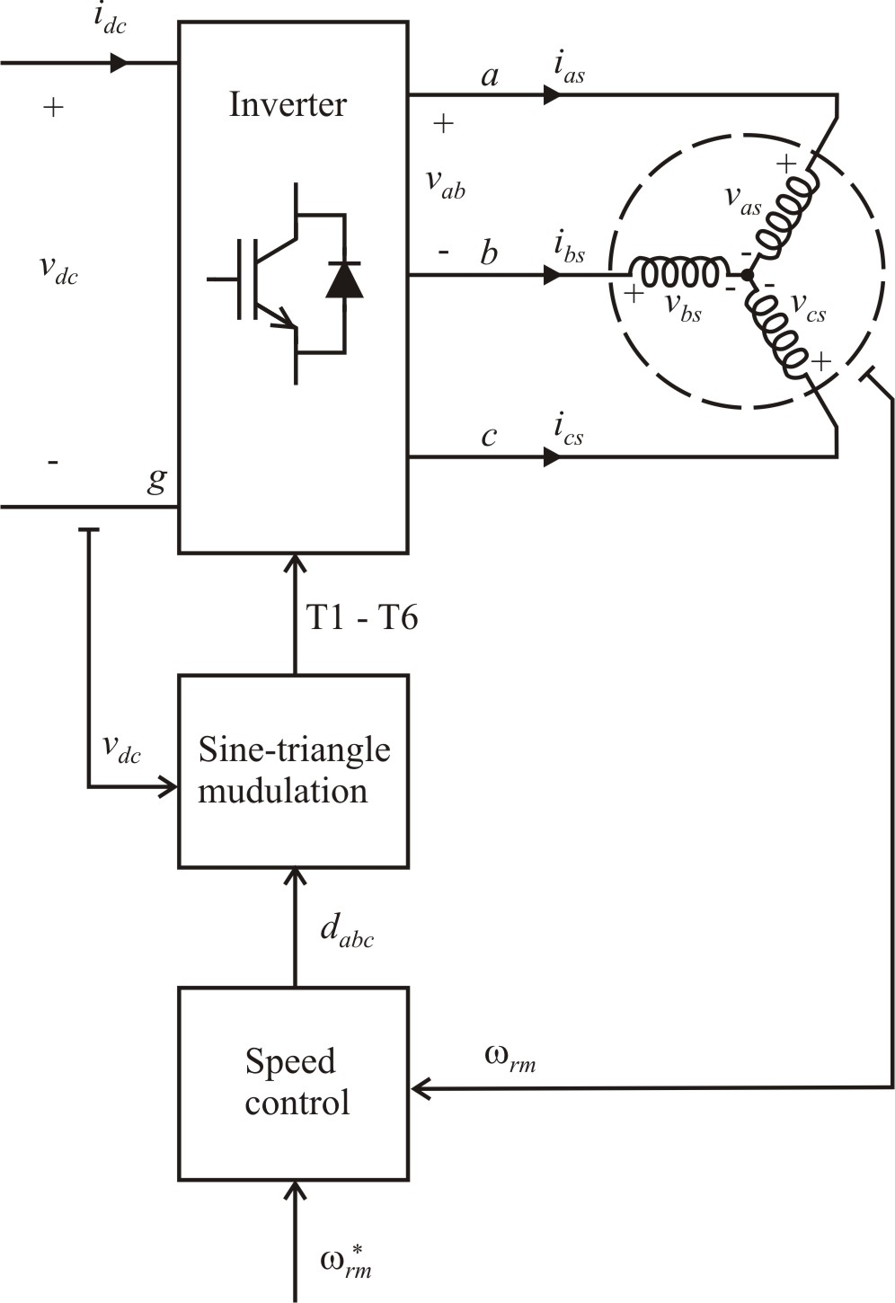
Brushless Dc Drive with Voltage Source PWM
PMSM motor
sine-triangle modulation
voltage regulation: φ_{v} = 0
speed control: PI
vehicle system

Slide 47
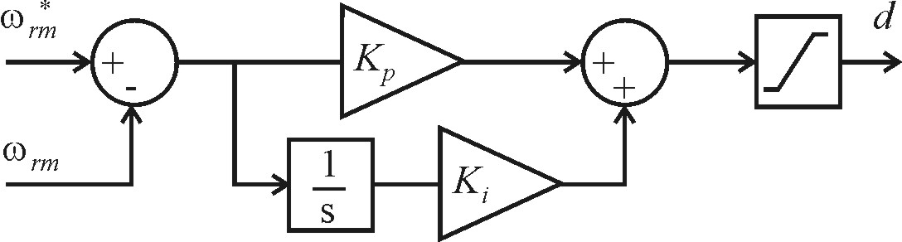
Voltage Control: q-Axis
effectively makes but
see book Figure 14.7-1

Slide 48
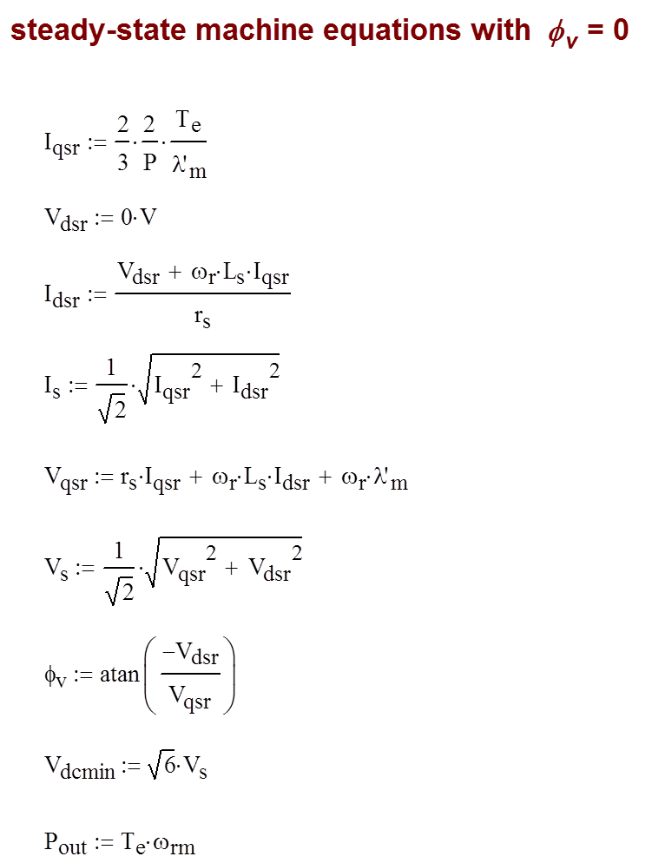
Permanent-Magnet Ac Machine Calculations (φ_{v} = 0)

Slide 49
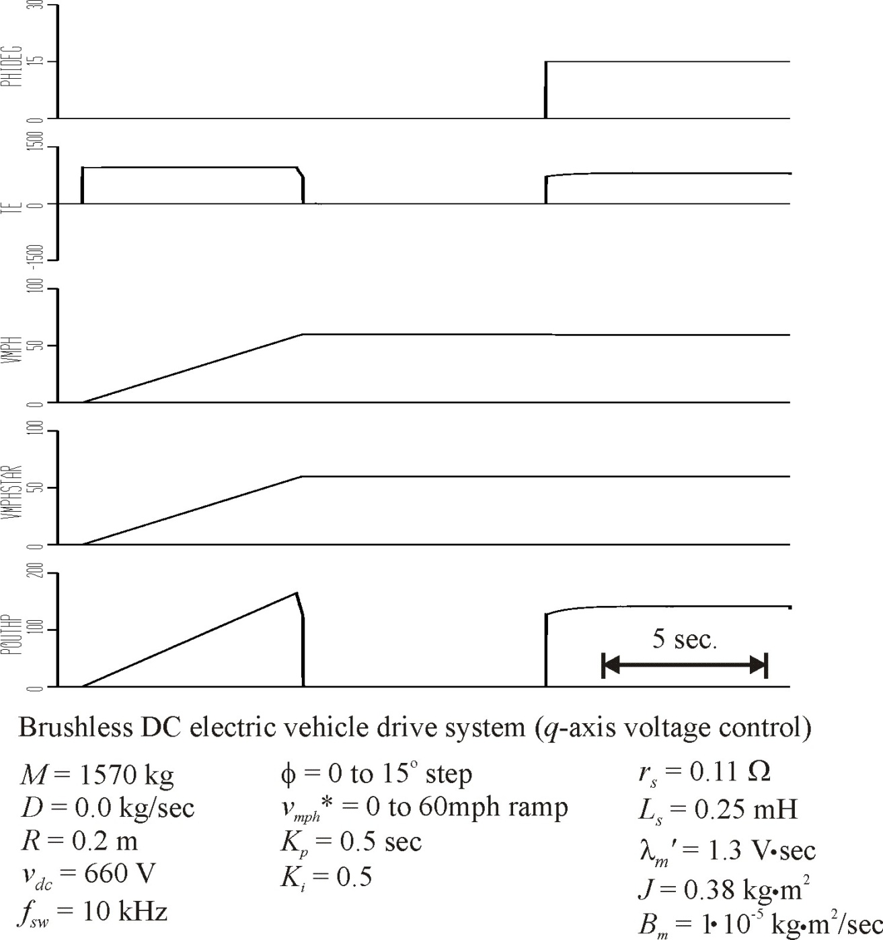

Slide 50
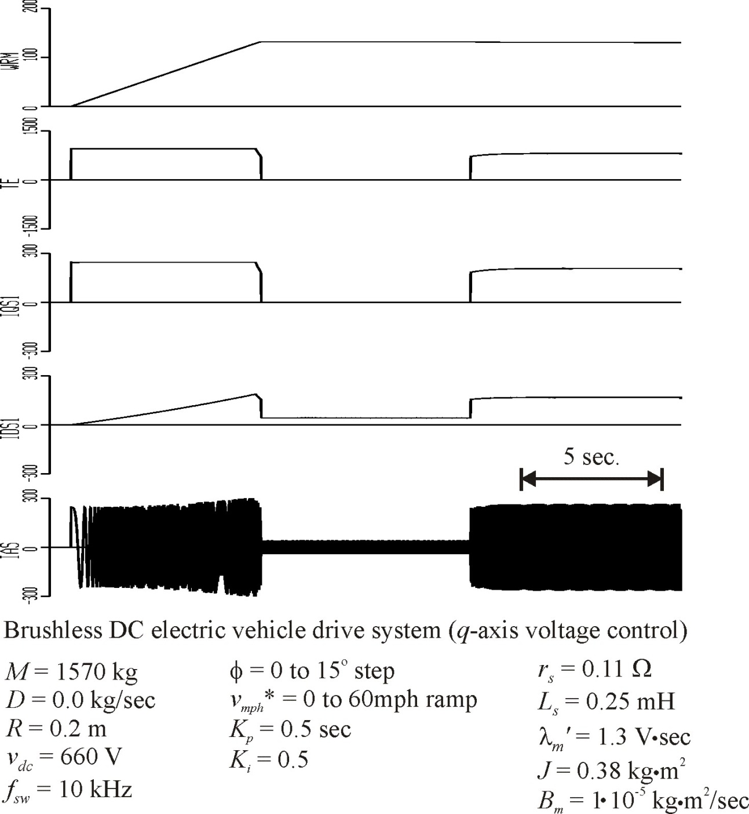

Slide 51
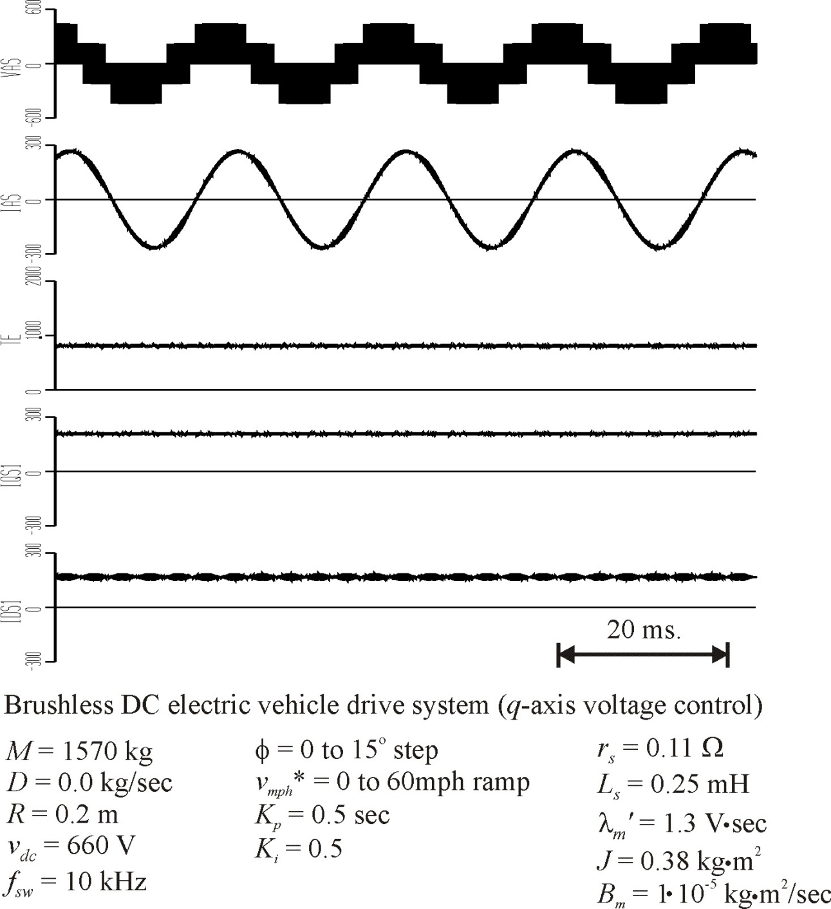

Slide 52
Compensation Control
determine commanded voltage from commanded currents
(14A-1)
(14A-2)
compute duty cycle and phase shift, apply sine-triangle modulation

Slide 53
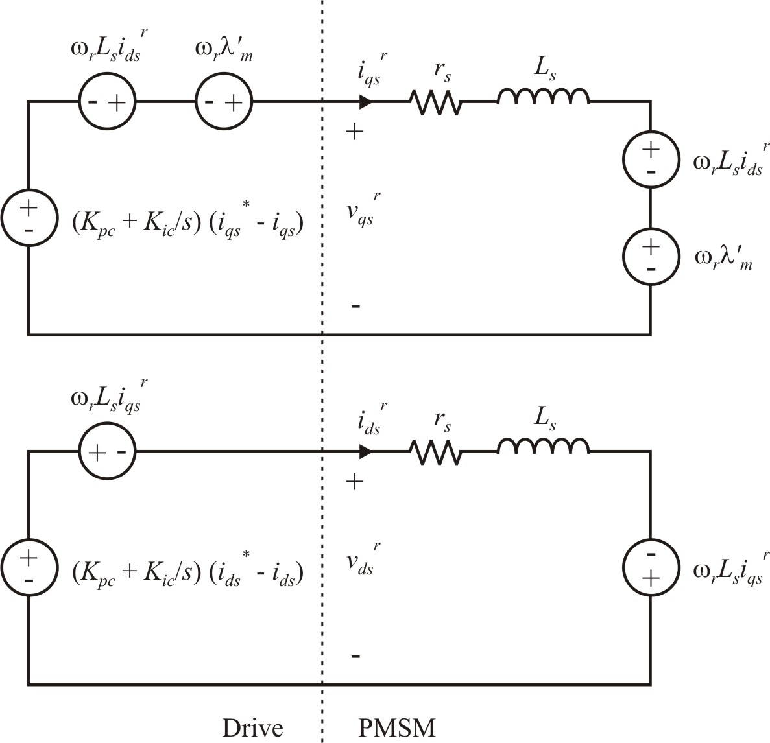
Compensation Control Effects

Slide 54
Transfer Function
for the q-axis:

Slide 55
Compensation Control Pole Placement

Slide 56
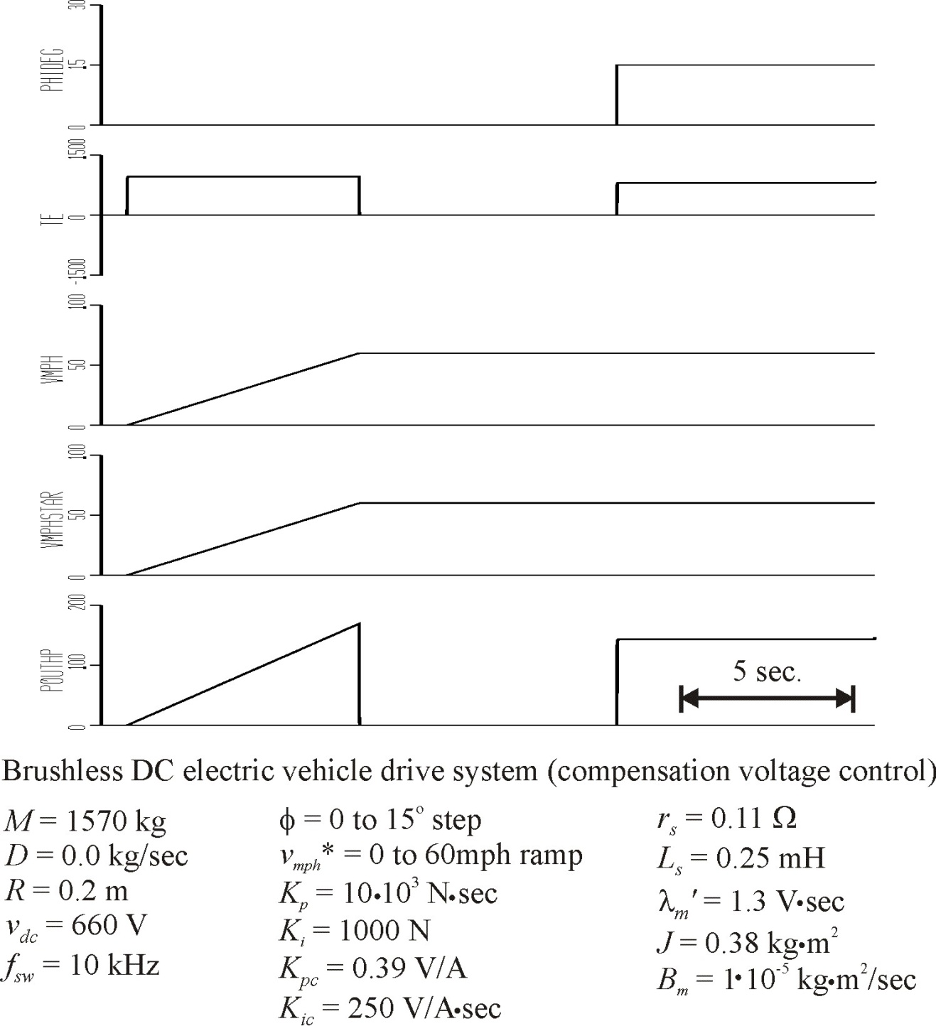

Slide 57
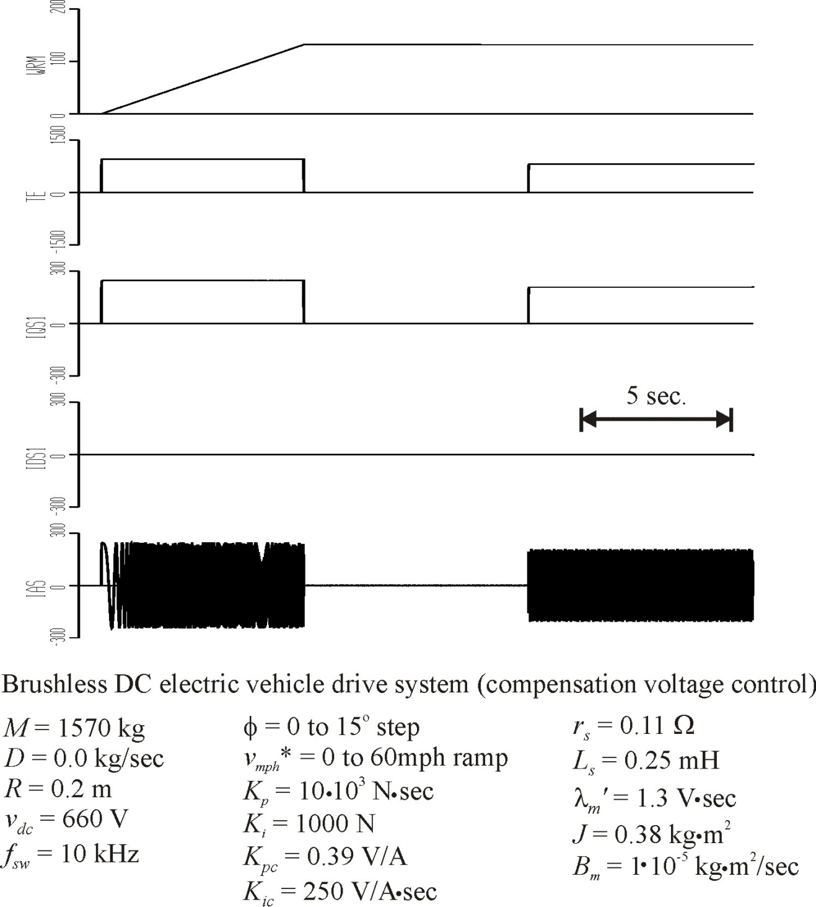

Slide 58
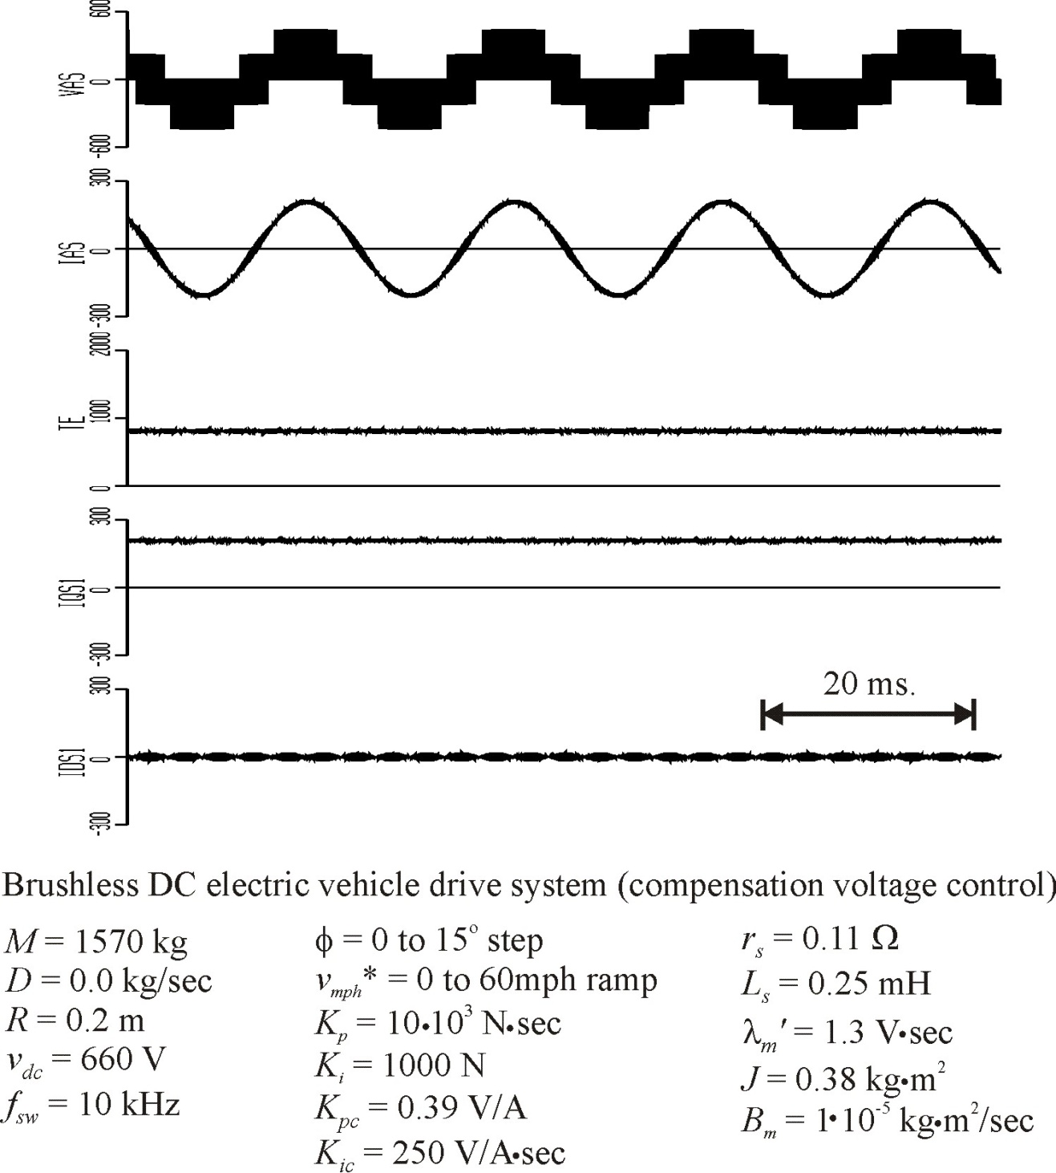

Slide 59
Voltage-Source Drive with Speed Control
Although the torque control demands commanded currents, a voltage-source PWM method is preferred in many drive applications because of better harmonic performance and consistent switching frequency.
One method of utilizing voltage-source PWM is to make the modulation index proportional to commanded torque. This method places the stator voltage in the q-axis and does not yield maximum torque per amp.
Cross-coupling compensation effectively turns commanded currents into commanded voltages so that voltage-source PWM can be readily used.

